Slide 1
A credit card is…
(Complete this sentence)

Slide 2
A credit card is a small plastic card issued by a bank, business, etc. allowing the holder to purchase goods or services on credit.
Notes:
Google Definition

Slide 3
APR stands for…
(Complete this sentence)

Slide 4
APR stands for Annual Percentage Rate. APR means the total amount a loan will cost across a one year period. Expressed as a single percentage.
Notes:
Google Definition

Slide 5
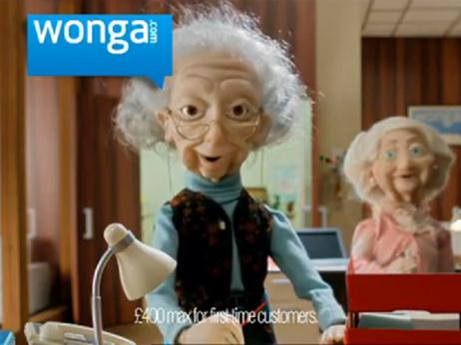
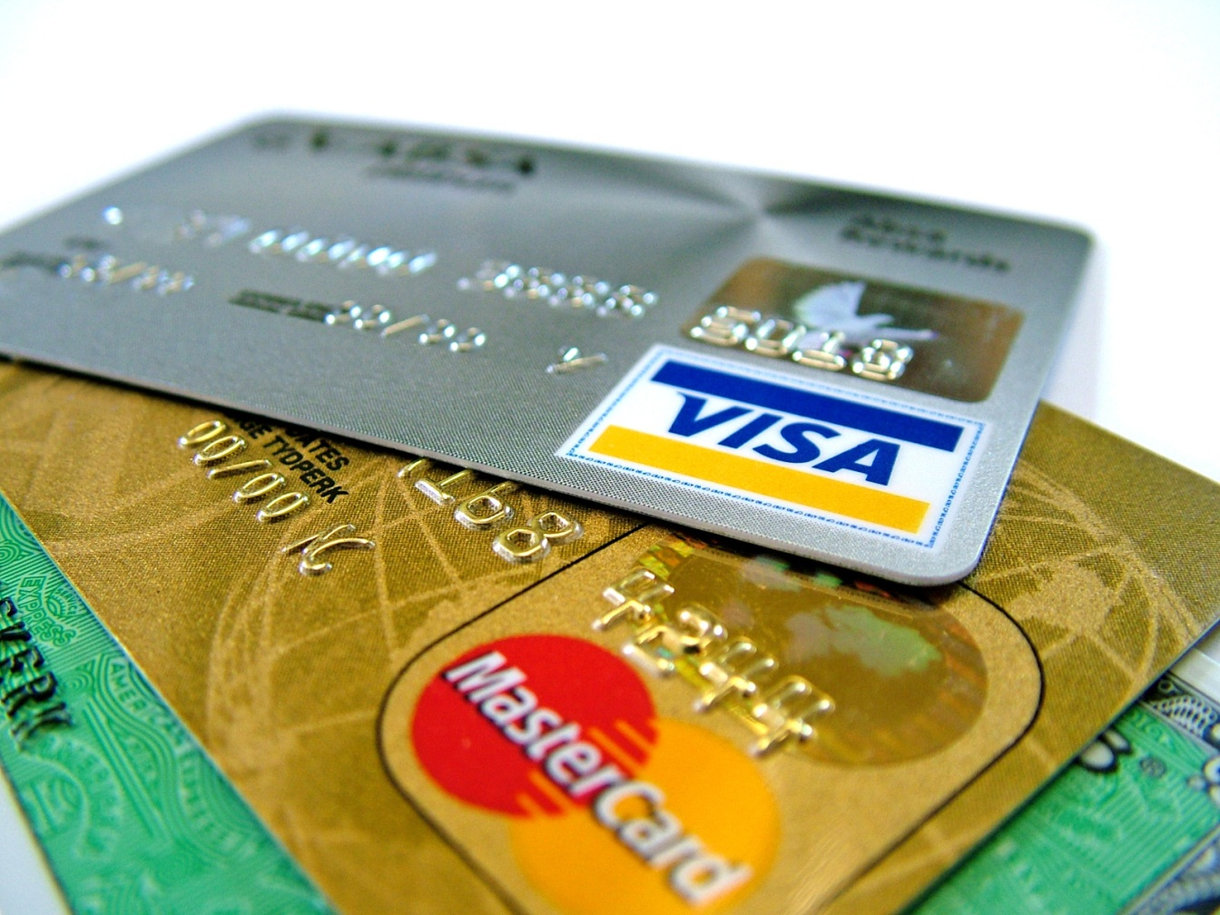

So when you need more moneY!

Slide 6



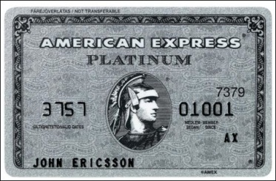
Credit Cards
How much do you know about credit cards?
Credit cards are like a loan from a bank or company.
Each credit card has an amount of money attached that you are allowed to spend. This is called a Limit.
When you spend on a credit card, you are effectively borrowing money from the company, which you will eventually have to pay back.
Notes:
http://www.thisismoney.co.uk/money/cardsloans/article-1633399/Calculator-Credit-card-repayment-reality-check.html

Slide 7
If you don't pay off the balance in full each month, you will have to pay interest. Remember, if you only pay off the minimum required each month, credit cards can be an expensive form of debt.
Not all cards are the same. Some charge an annual fee, some don't. And interest and APR rates can vary a lot.

Slide 8
APR
It stands for Annual Percentage Rate and illustrates how much your credit card, loan, or other form of credit will cost per year.
For example, if you had a loan with an APR of 7.7%, this would mean that for each year that the loan was outstanding, 7.7% of the amount borrowed would be added to the total amount you would have to repay.

Slide 9

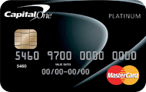

Card 1
Card 2
Card 3
Barclaycard
Platinum Credit Card
APR: 18.9%
Limit: £1,200
Capital One
Classic Platinum
APR: 29.8%
Limit: £1,500
Vanquis Visa Credit Card
APR: 39.9%
Limit: £3000
Your task
On each credit card you have to borrow £1200 .
you need to work how much you will need to repay over:
1 years
3 years
5 years
(Hint remember APR!)
Enter Answers on Next Slide

Slide 10
Card | APR % | 1 year | 3 years | 5 years
Card 1 | 18.9
Card 2 | 29.8
Card 3 | 39.9
1 Year = 12 months 3 Years = 36 months 5 Years = 60 months

Slide 11

Class discussion
“Are credit cards a good idea?”

Slide 12
What are the Pros of a Credit Card?
Good for emergencies
Good for treating yourself
Help you to manage your money better
Can assist with getting you a good credit rating.

Slide 13
What might the problems be with a credit card?
Irresponsible spending.
Running out of money because you are paying off debts, so having to spend more on the card.
If you miss a re-payment, you will get charged a fee/fine.

Slide 14
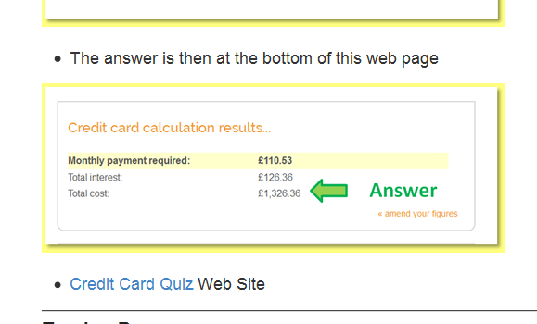
A quick Online Credit Card quiz
Follow the link below and take the quiz
Note your final score
http://money.howstuffworks.com/personal-finance/debt-management/credit-card-quiz.htm
This Link is also on the finance web site

Slide 15
Your task
To design your own Credit Card [Choose only one option]
Option 1
Design a credit card with high borrowing and high APR
Describe the advantages and disadvantages of your card
Option 2
Design a credit card with low borrowing and low APR
Describe the advantages and disadvantages of your card
Option | APR | Borrowing Limit | Advantages | Disadvantages

Slide 16
Let’s see your credit cards
?

